Slide 1

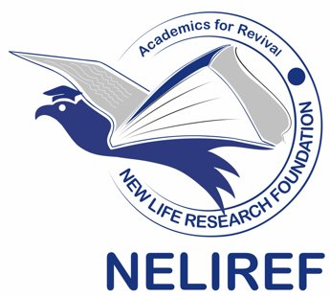





2nd Data Science & AI Summer School 2025
Object Oriented Programming (OOPs) Concepts in Python
Instructors: Amos Aondover Kwaghfan and Joseph Luper Tsenum
Teaching Assistant (TA): Alexander Takele Mengesha
June 27, 2025
+1 (678) 975-5615
www.neliref.org
contact@neliref.org
New Life Research Foundation (NELIREF) Ltd/Gte
Notes:
Good afternoon everyone!
Thank you for being here today.
We are Bio-PrecisionAI we’re passionate about changing the game in drug discovery using AI. Right now, we’re focused on developing small drug molecules for Parkinson’s disease, a condition that impacts over 10 million people worldwide and still doesn’t have a cure.
Our AI platform is designed to accelerate drug discovery, improve treatment outcomes, and address the urgent needs of patients. Now, we’d like to take you through how we’re turning this vision into reality.

Slide 2
Introduction to OOPs in Python
Object Oriented Programming (OOPs) is a paradigm that structures programs around objects, which bundle data (attributes) and functions (methods) together.
It enhances code reusability, modularity, and scalability especially valuable in large-scale systems and AI applications.
Python is a multi-paradigm language that offers intuitive syntax and strong support for OOPs.
It's widely used in AI and data science due to its readability and extensive libraries, and OOPs helps in organizing complex data science workflows.

Slide 3
Class and Object
A class is a blueprint for creating objects.
An object is an instance of a class with specific values.
class Dog:
def __init__(self, name):
self.name = name
def bark(self):
print(f"{self.name} says Woof!")
dog1 = Dog("Buddy")
dog1.bark() # Output: Buddy says Woof!
Methods are functions that belong to an object or class.
Attributes are variables that belong to an object or class. They define the properties of the object.
Attributes that are specific to each instance of a class.
They are defined within methods, typically within the ‘_init_’ method, and are prefixed with ‘self’ to indicate that they belong to the instance.

Slide 4
Instance vs Class Variables
Iinstance Variables: Defined within methods using self; unique for each object.
Class Variables: Shared among all instances; defined directly in the class body.
class Student:
school = "AI Summer School" # Class variable
def __init__(self, name):
self.name = name # Instance variable
s1 = Student("Alex")
s2 = Student("Sam")
print(s1.school) # Output: AI Summer School
print(s2.name) # Output: Sam

Slide 5
Encapsulation
It restricts access to internal object details. It helps protect data from unintended modification.
Public attributes: Accessible from anywhere.
Protected attributes (_var): Intended for internal use only.
Private attributes (__var): Strictly hidden from outside the class.
We use getter and setter methods to safely access and update private data.
class BankAccount:
def __init__(self, balance):
self.__balance = balance # private variable
def deposit(self, amount):
self.__balance += amount
def get_balance(self):
return self.__balance

Slide 6
Inheritance
Inheritance allows a class (child) to inherit features from another class (parent), promoting code reuse.
Base class: The general class
Derived class: Extends or overrides the base class
class Animal:
def speak(self):
print("Animal speaks")
class Dog(Animal):
def speak(self):
print("Dog barks")
d = Dog()
d.speak() # Output: Dog barks

Slide 7
Polymorphism
Polymorphism means the same method name can perform different behaviors based on the object calling it
class Cat:
def speak(self):
print("Meow")
class Dog:
def speak(self):
print("Woof")
def make_sound(animal):
animal.speak()
make_sound(Cat()) # Output: Meow
make_sound(Dog()) # Output: Woof

Slide 8
Abstraction
Abstraction hides complex implementation details and shows only essential features. In Python, abstraction is implemented using abstract base classes with the abc module.
Use @abstractmethod to define required methods.
Abstract classes can't be instantiated directly.
from abc import ABC, abstractmethod
class Shape(ABC):
@abstractmethod
def area(self):
pass
class Circle(Shape):
def __init__(self, radius):
self.radius = radius
def area(self):
return 3.14 * self.radius ** 2

Slide 9










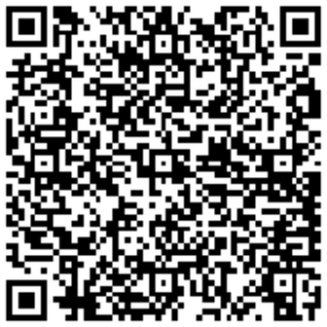



Thank You!
Connect with Us!
We admonish you to live for God and connect with our community!
New Life Research Foundation (NELIREF) Ltd/Gte
Contact @neliref.org newliferesearchfoundation2013@gmail.com
www.neliref.org
+1 (678) 975-5615

